Slide 1


FootballStats - itucsdb1930 2019-20 Fall Database Systems Project
THE LEAGUE OF WORLD
Contributors:
Muhammed Enes Tırnakçı – 150160038
Beraat Buz – 150160002
Ahmet Yılmaz - 150160805

Slide 2
Objectives of FootballStats:
Keeping informations of players, managers, teams, referees, stadiums
Starting and controlling live matches
Showing statistics about played matches
Showing top assist and top goal players
**This system follows live football matches and keep some statistic about players, teams, matches, stadiums, referees, over the matches played before in England Premier League.

Slide 3
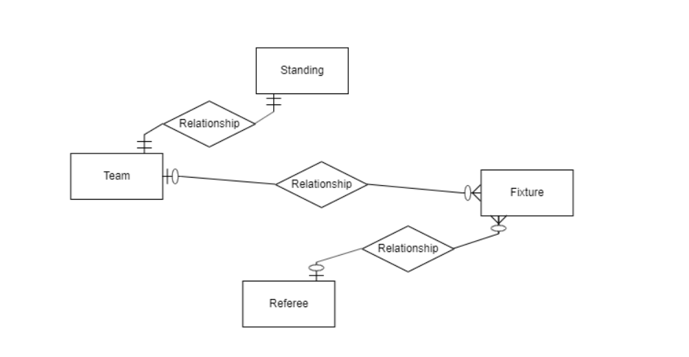
Beraat Buz
- Standing, fixture, and referee tables

Slide 4
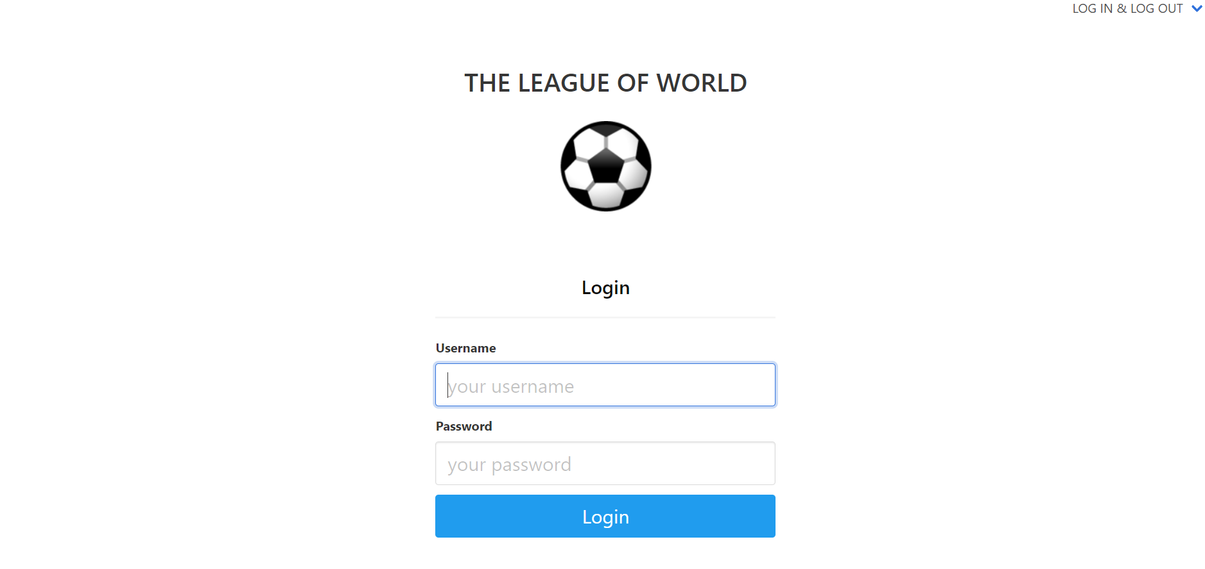
The administrator can login to operate CRUD operations

Slide 5
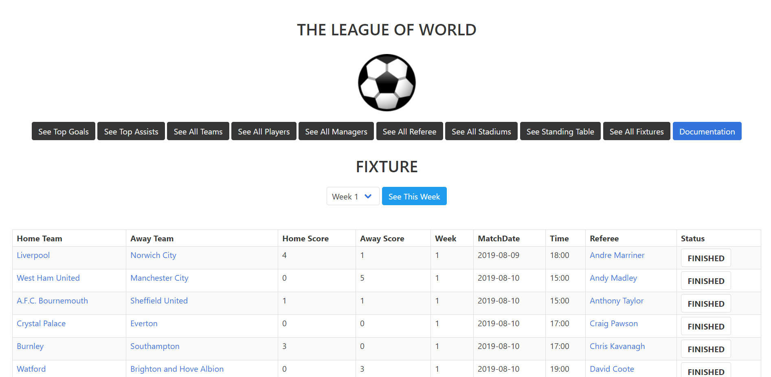
The user can see all fixtures up to week 4, and control the status of matches. Moreover, the user can reach more information about the match using status buttons.

Slide 6
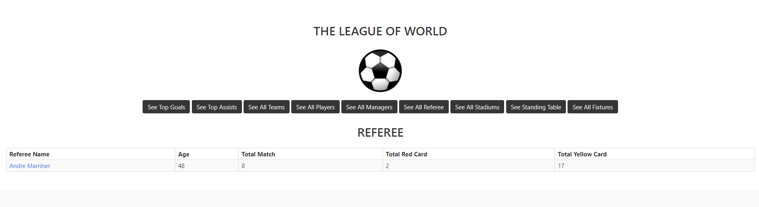
The user can see some information about the referee by clicking referee name at fixture page.

Slide 7
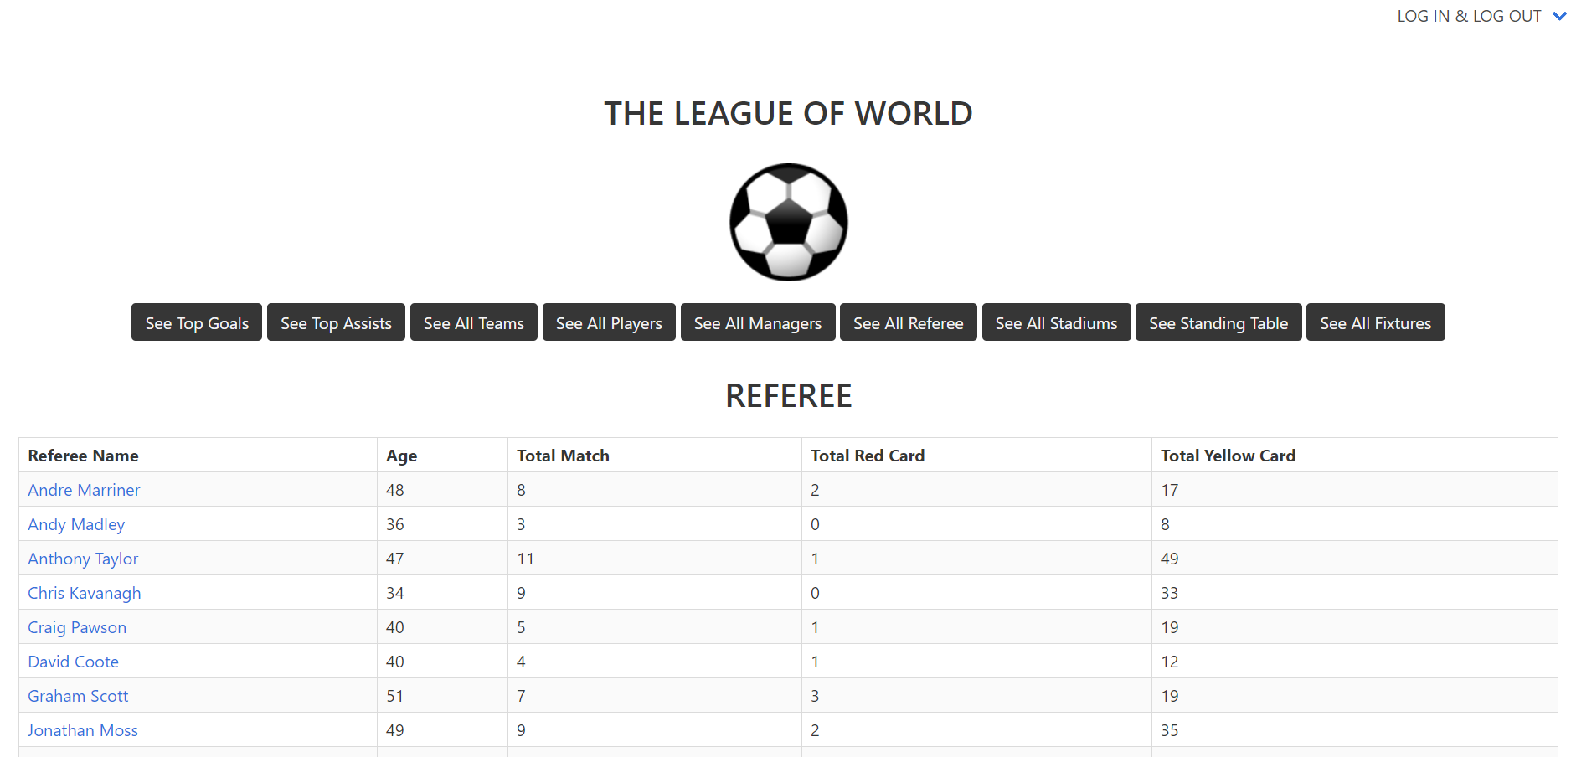
The user can see some information about all referees.

Slide 8
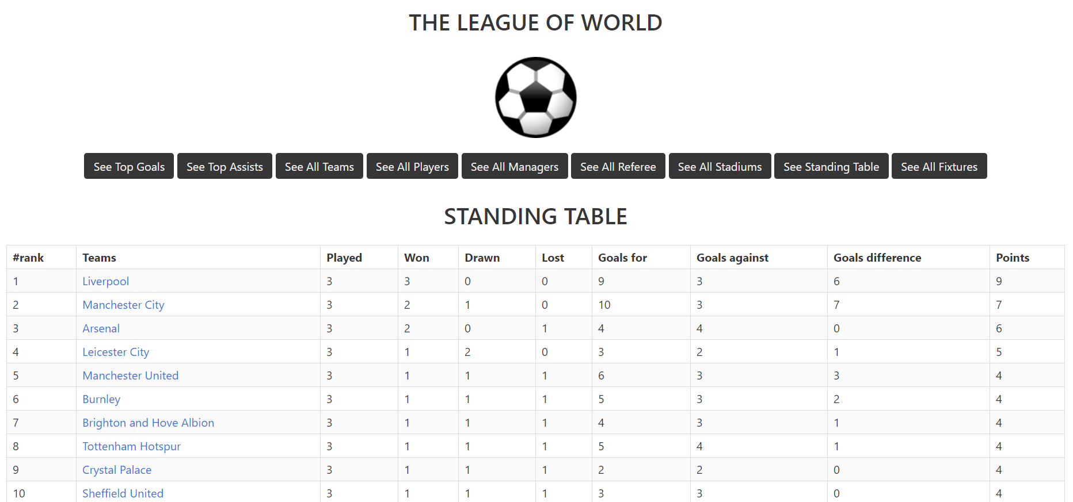
The user can see standing table in the EPL.

Slide 9
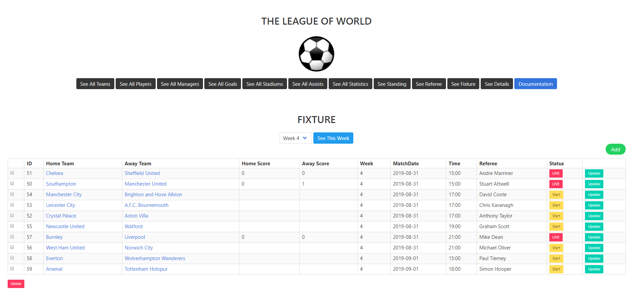
After login, in the beginnig the page in which add, update, delete and starting the match operations about fixture can be done seen. The administrator can do these operations. Delete operation is operated by using checkboxes.

Slide 10
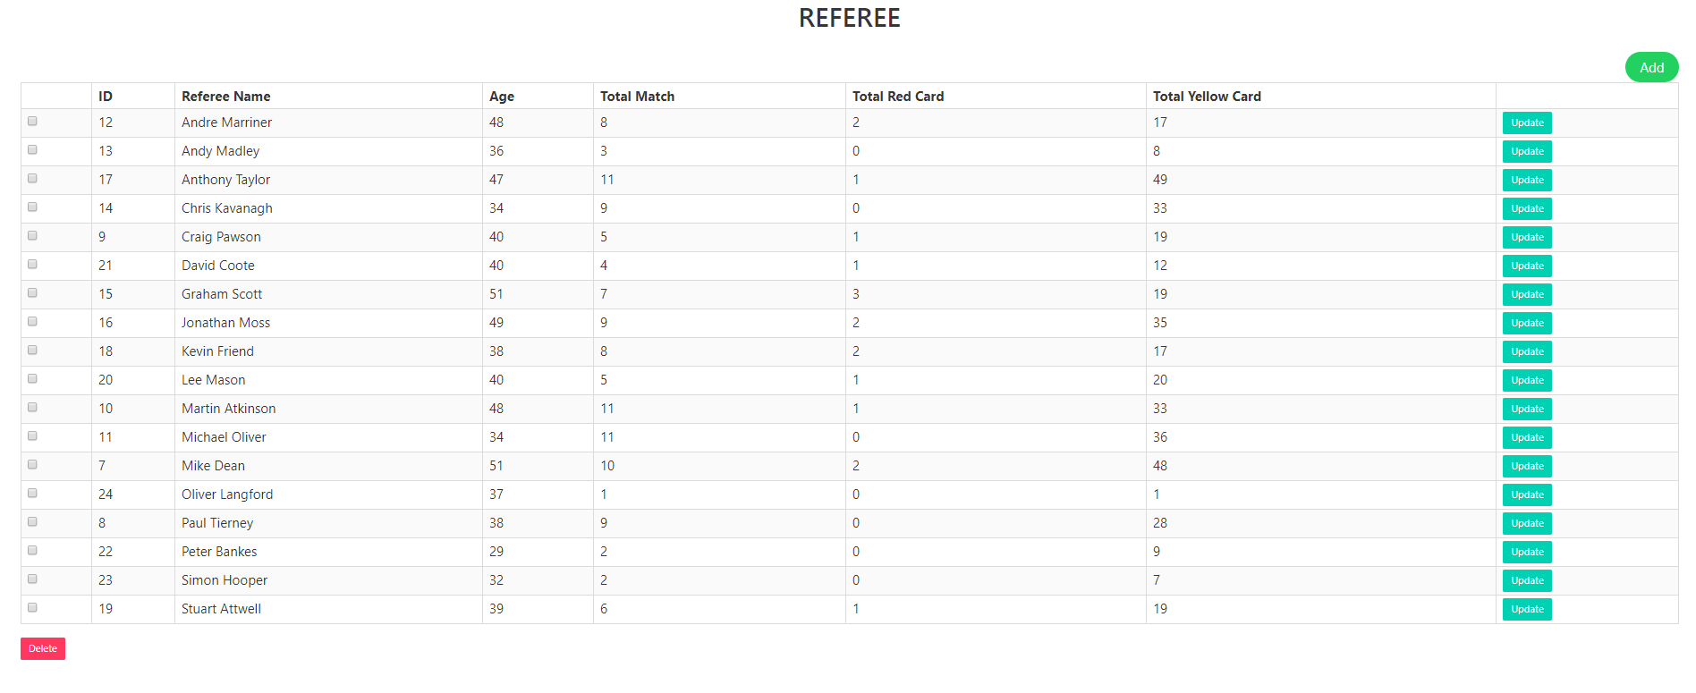
After login, by clicking see all referee the page in which add, update and delete operations about referees can be done seen. The administrator can do these operations. Delete operation is operated by using checkboxes

Slide 11
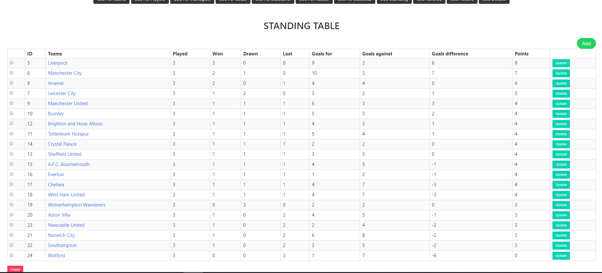
After login, by clicking see standing table the page in which add, update and delete operations about standing table can be done seen. The administrator can do these operations. Delete operation is operated by using checkboxes

Slide 12
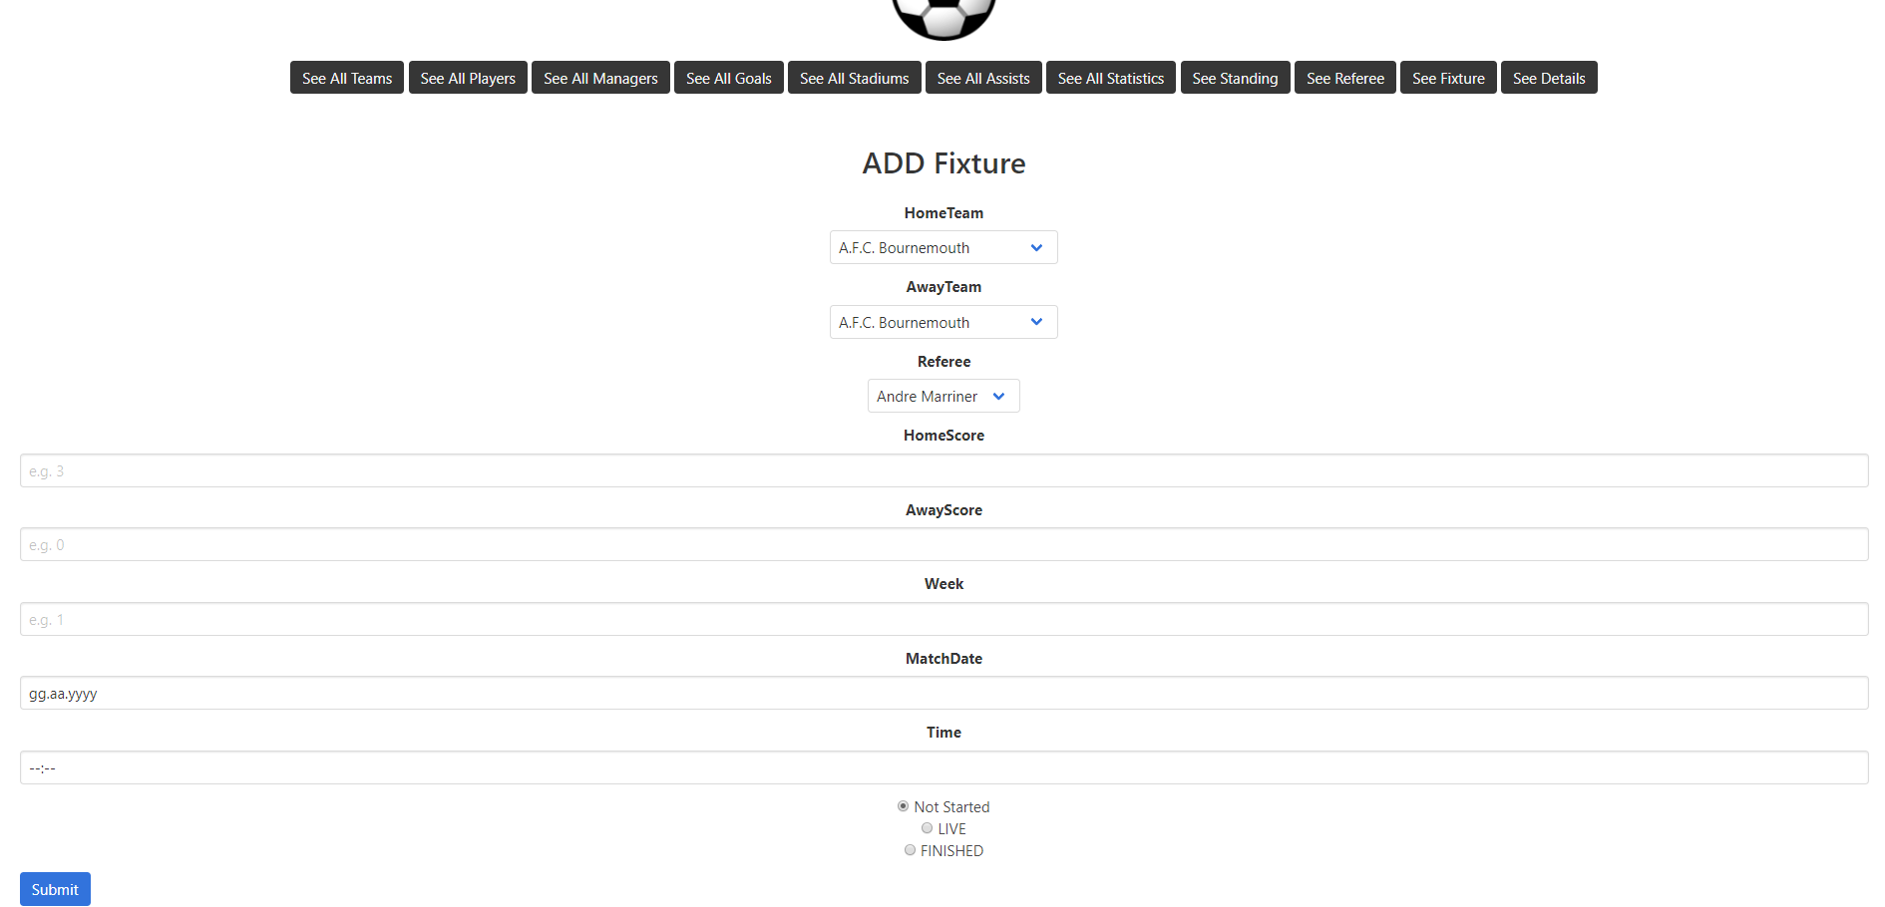
The administrator can add more fixtures in this page.

Slide 13
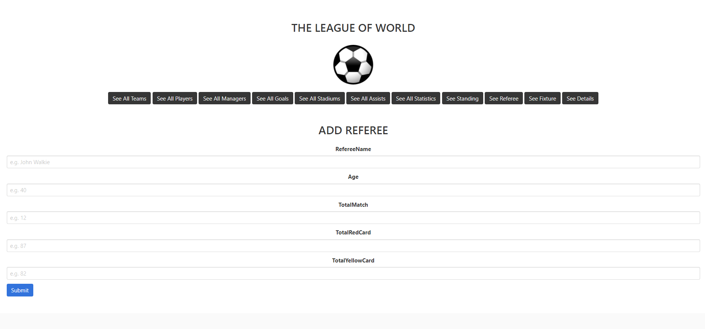
The administrator can add more referees in this page.

Slide 14
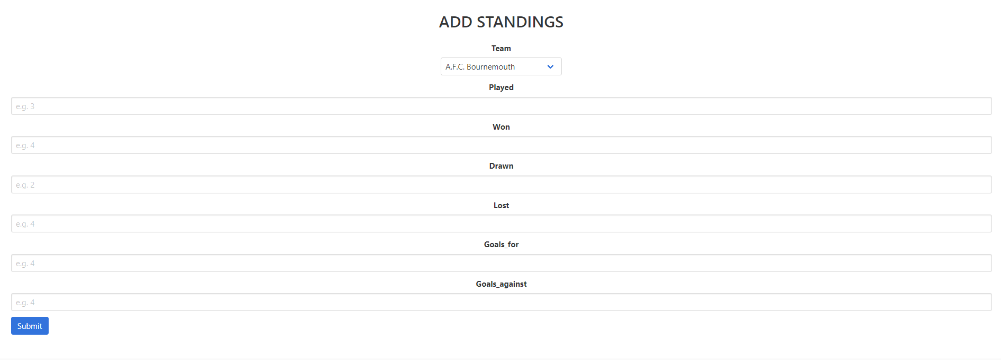
The administrator can add more teams to standing table in this page.

Slide 15
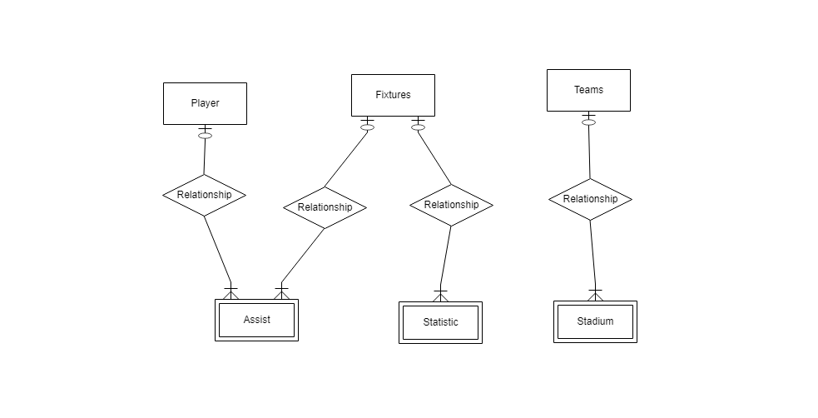
Ahmet Yılmaz
Asisst, Statistic, Stadium, and MatchDetails tables

Slide 16
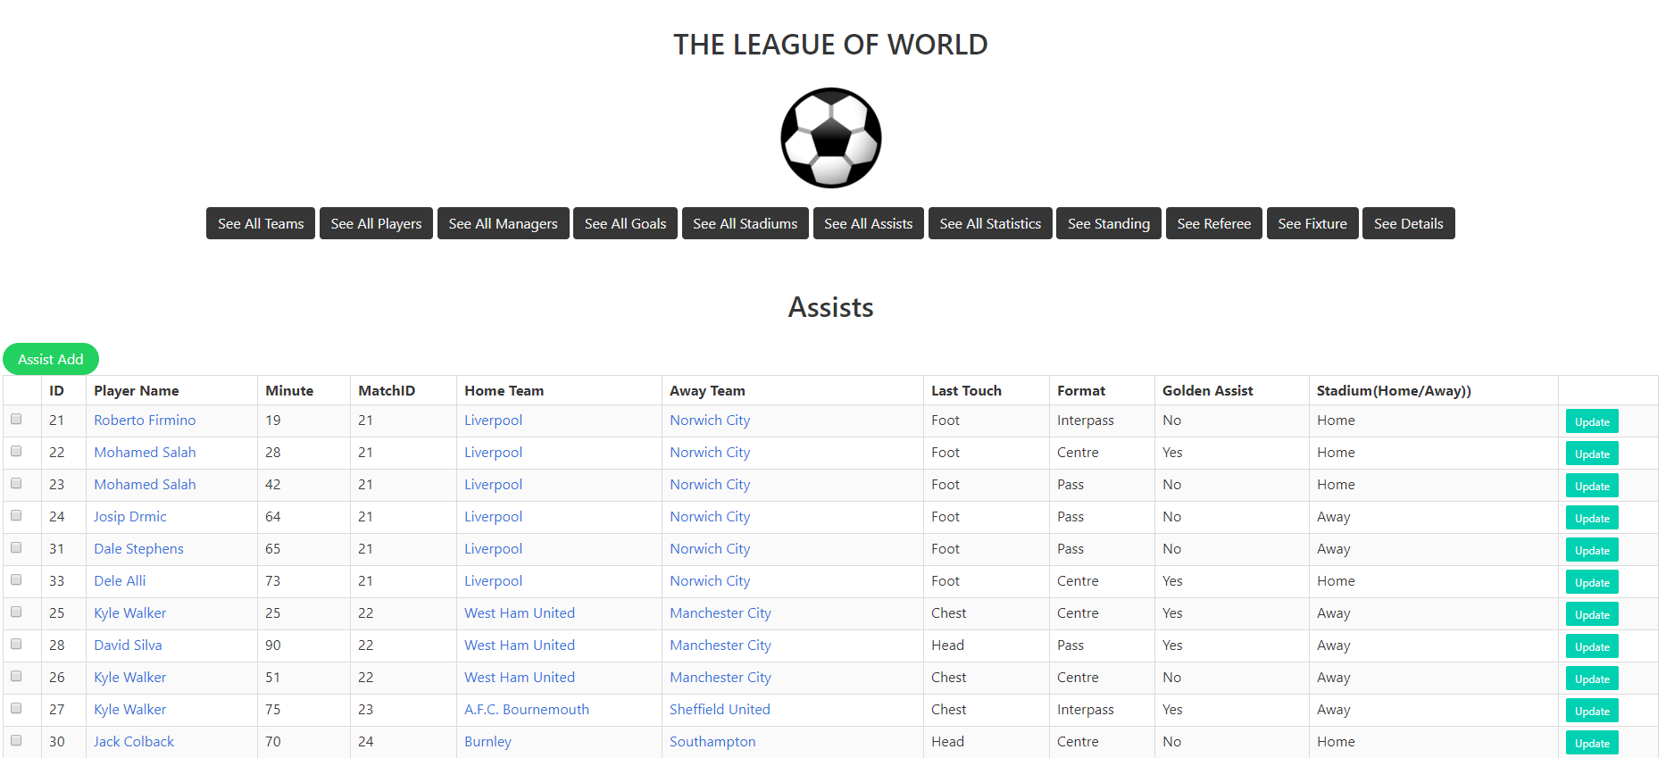
After login the website, the developer guy can see the assists for all match by clicking ‘See All Assists’ button. The developer also can add, update and delete the assists by clicking the buttons.

Slide 17
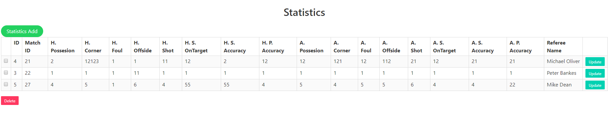
After login the website, the developer guy can see the statistic for all match by clicking ‘See All Statistics’ button. The developer also can add, update and delete the statistic by clicking the buttons.

Slide 18
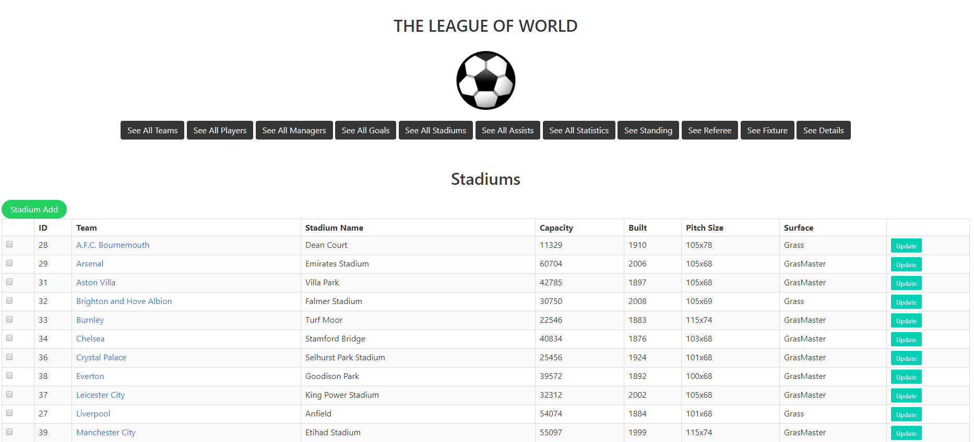
After login the website, the developer guy can see the stadiums for all teams by clicking ‘See All Stadiums’ button. The developer also can add, update and delete the by clicking the buttons.

Slide 19
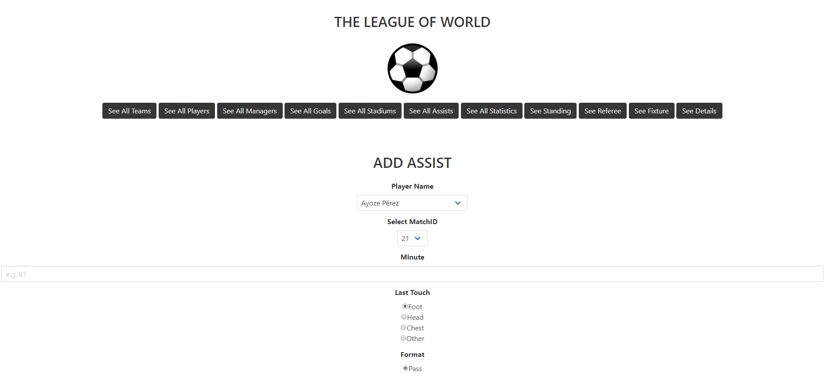
Assist addding page for developer.

Slide 20
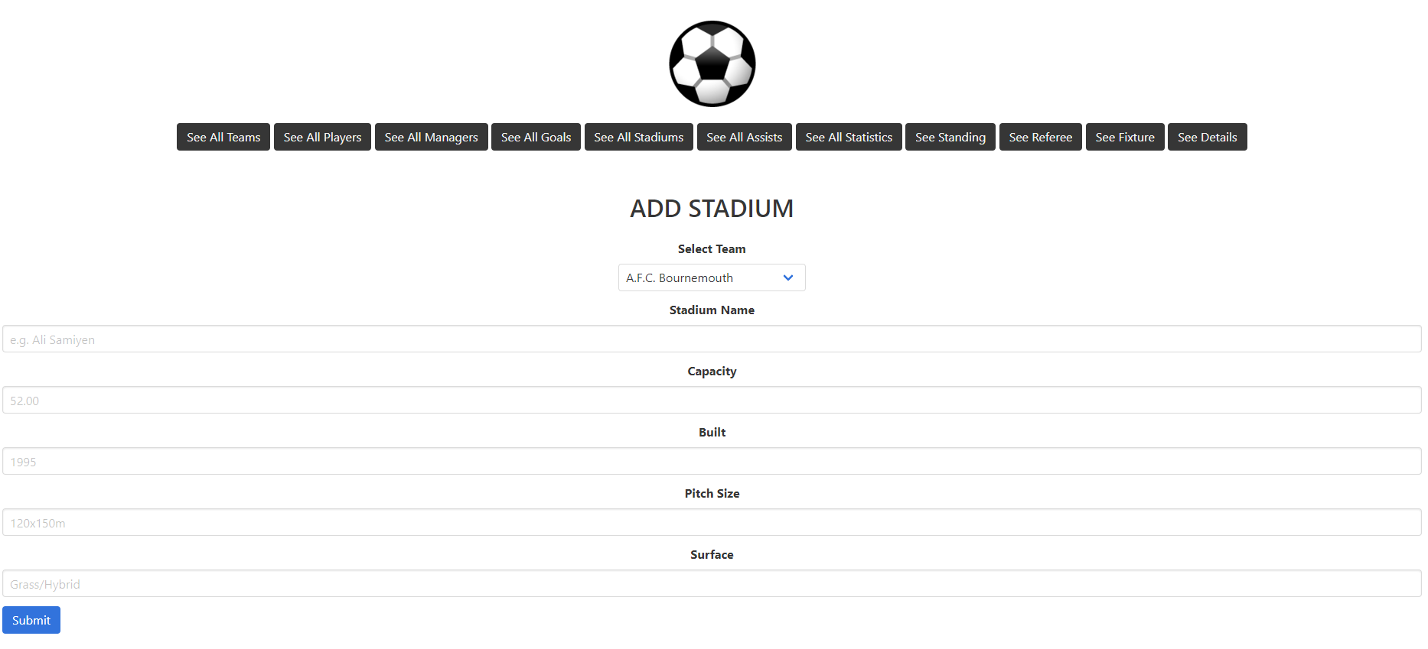
Stadium addding page for developer.

Slide 21
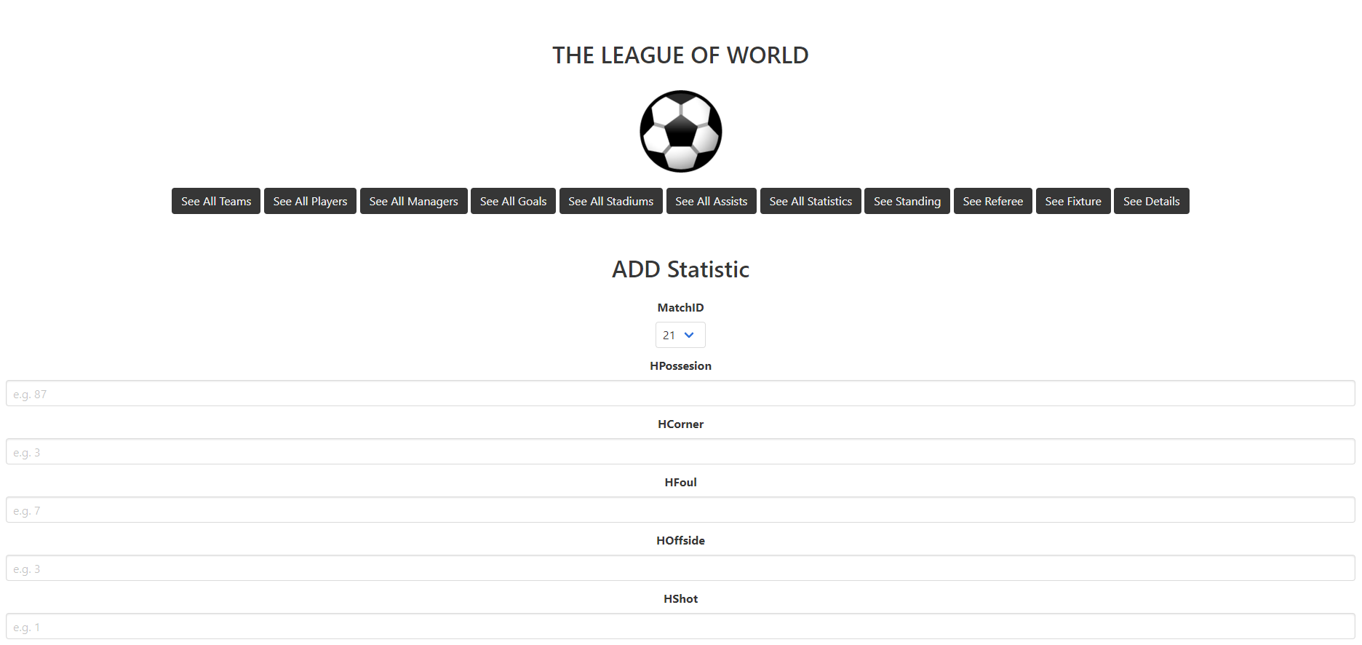
Statistic adding page for developer.

Slide 22
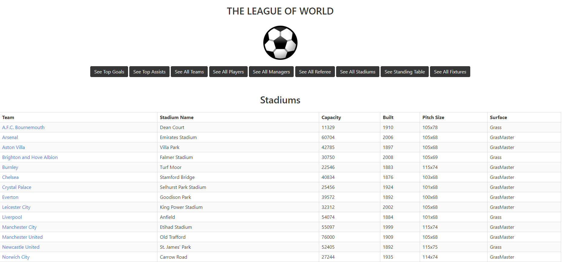
The user can see all stadium of teams by clicking the ‘See All Stadiums’ button.

Slide 23
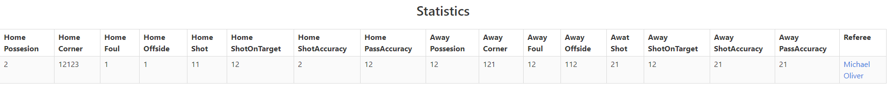
The user can see statistic of a match by clicking match details on the fixture page.

Slide 24
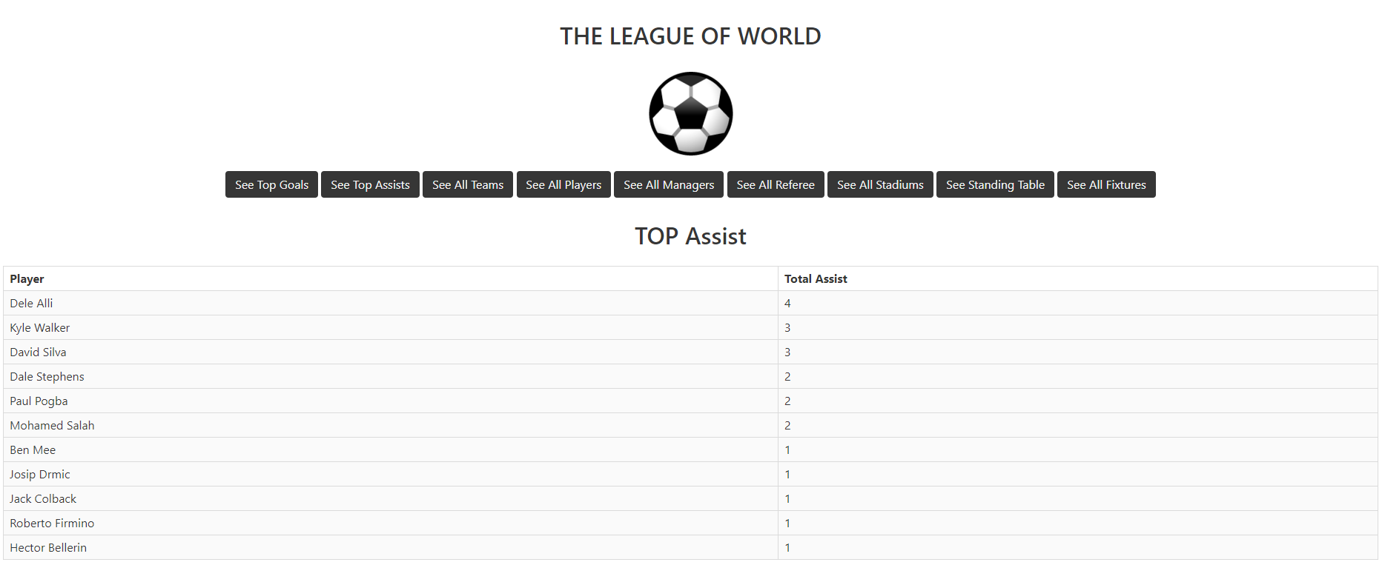
The user can see top assist player in this page by clicking the ‘See Top Assists’ button.

Slide 25
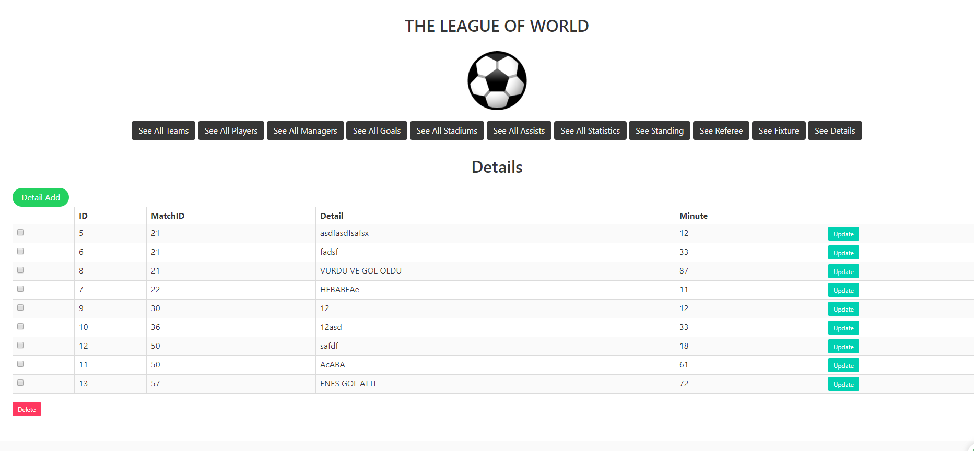
After login the website, the developer guy can see the details for all teams by clicking ‘See All Details’ button. The developer also can add, update and delete the by clicking the buttons.

Slide 26
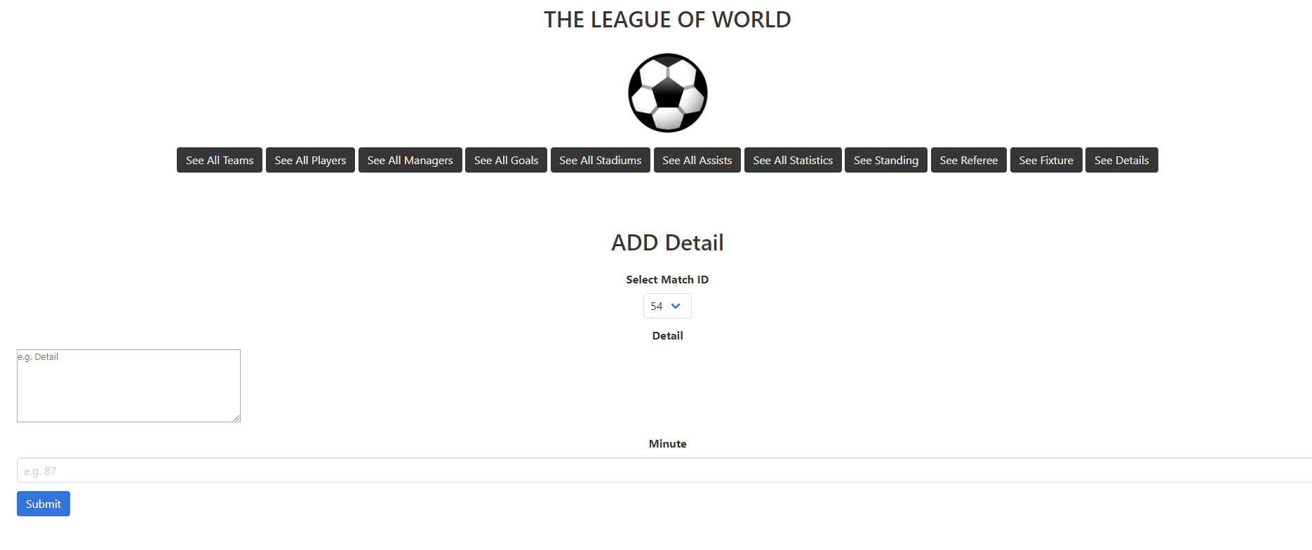
Stadium adding page for developer.

Slide 27
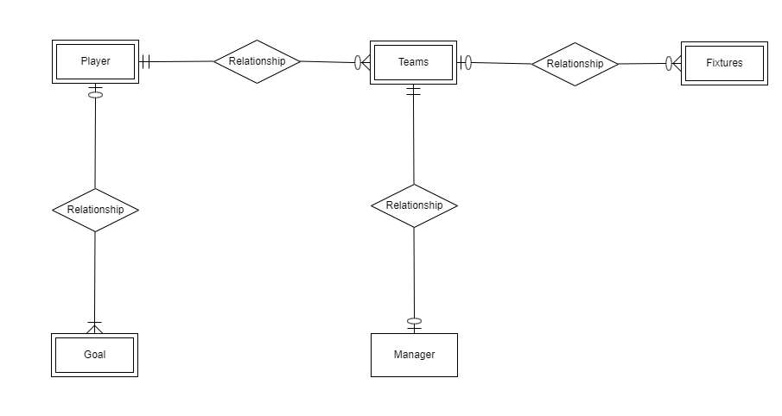
Muhammed Enes Tırnakçı
- Teams, player, manager, and goal tables

Slide 28
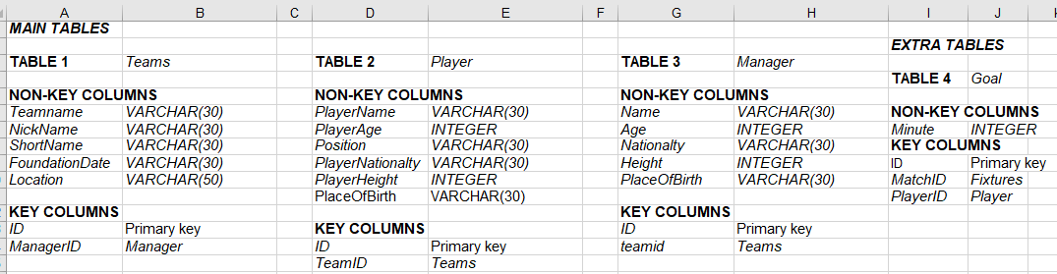
TABLES

Slide 29
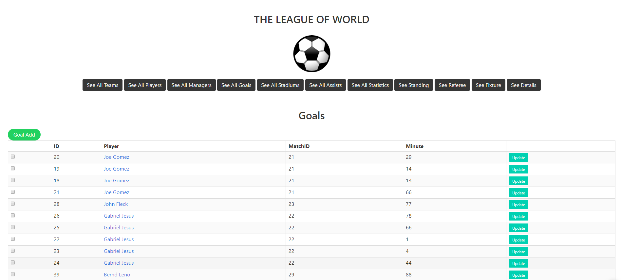
After logging in, the developer can see all goals in this page by clicking the ‘See All Goals’ button. Developer can delete and update the goals.

Slide 30
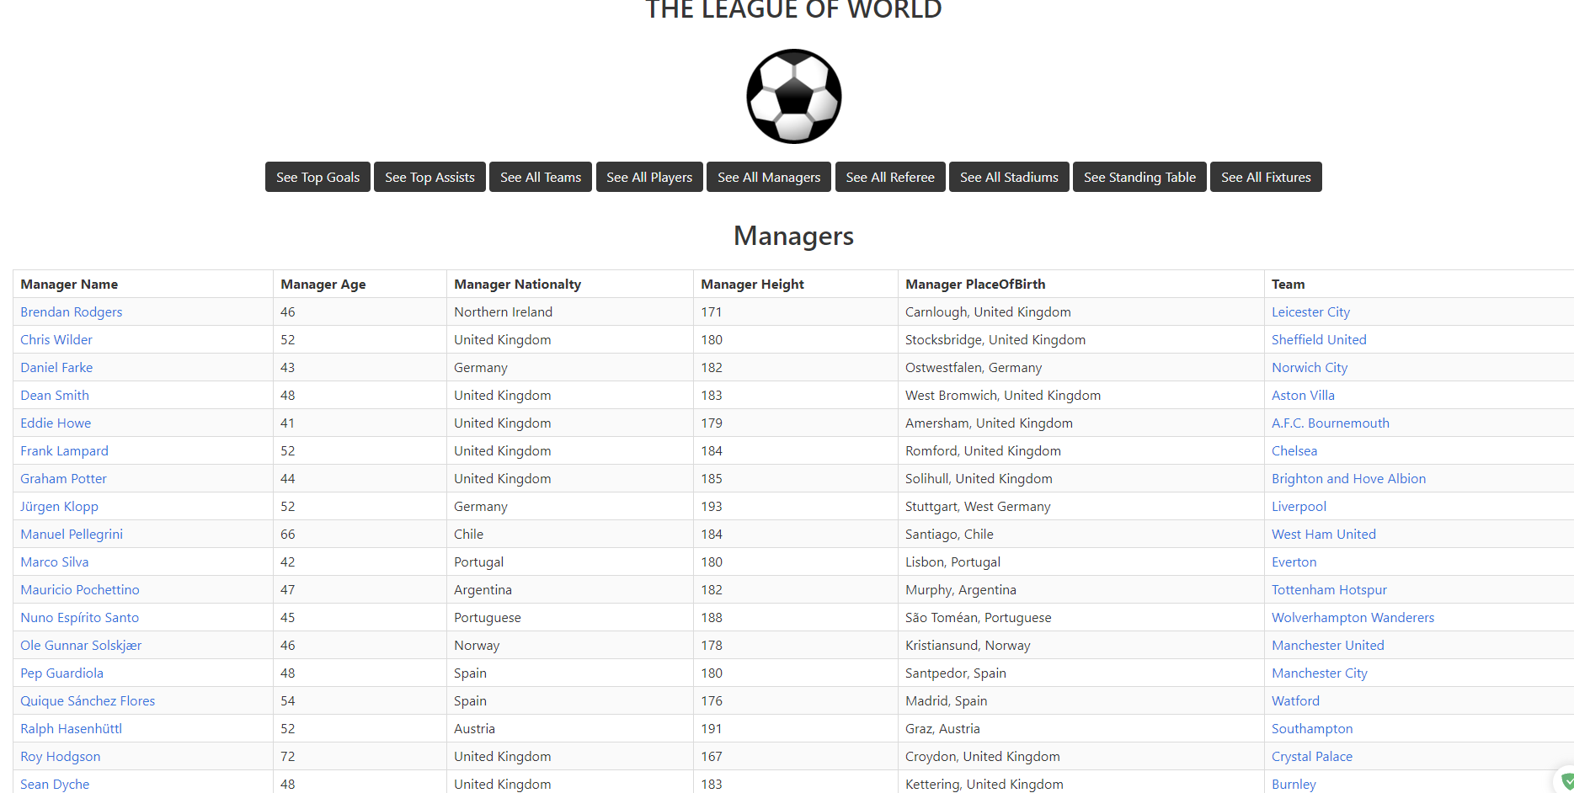
The user can see all managers in this page by clicking the ‘See All Managers’ button.

Slide 31
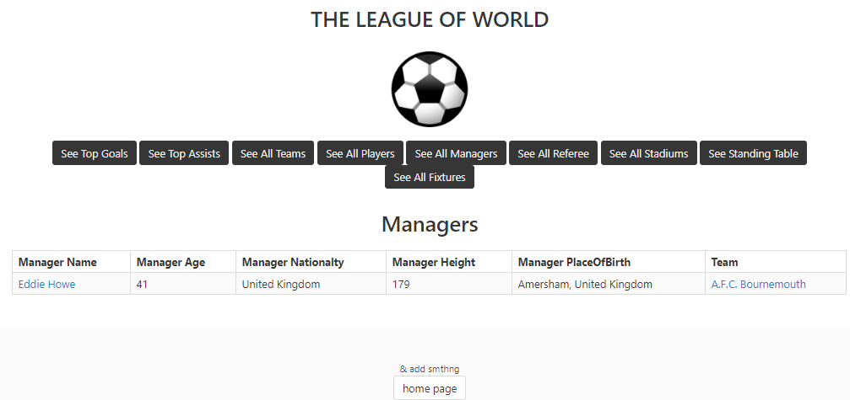
Key access for managers table in user mode. Clicking name of the manager in list of
manager page or in the teams page will redirect to this page.

Slide 32
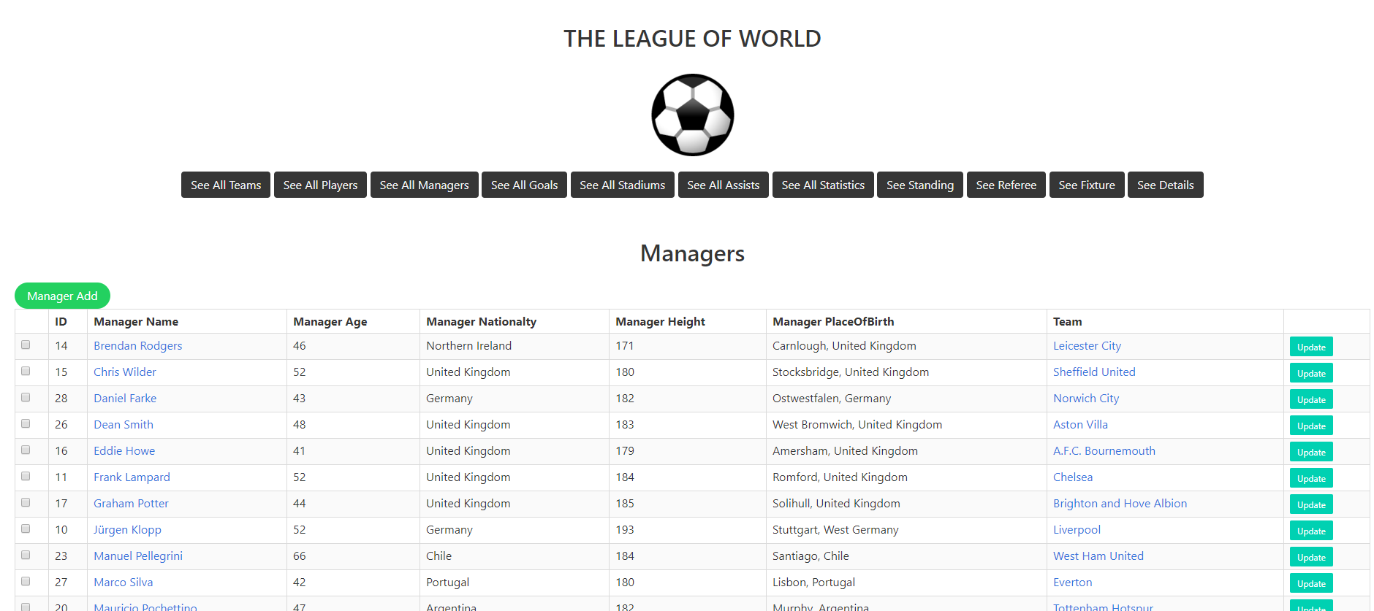
After logging in, the developer can see all managers in this page by clicking the ‘See All Managers’ button. Developer can delete and update the managers.

Slide 33
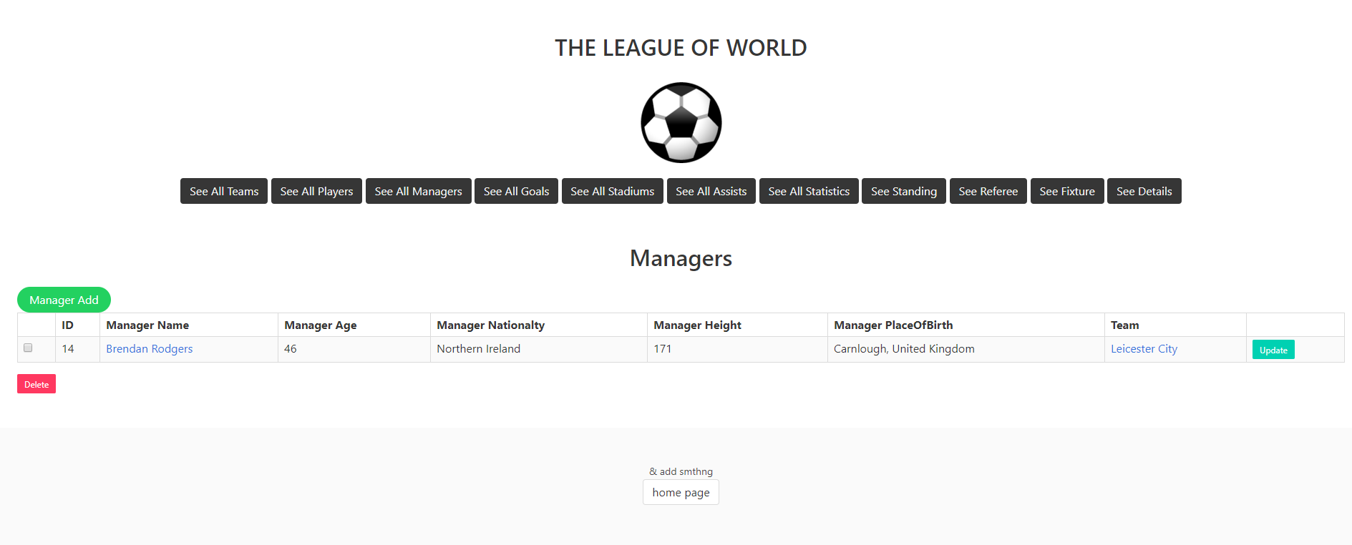
Key access for managers table in developer mode.

Slide 34
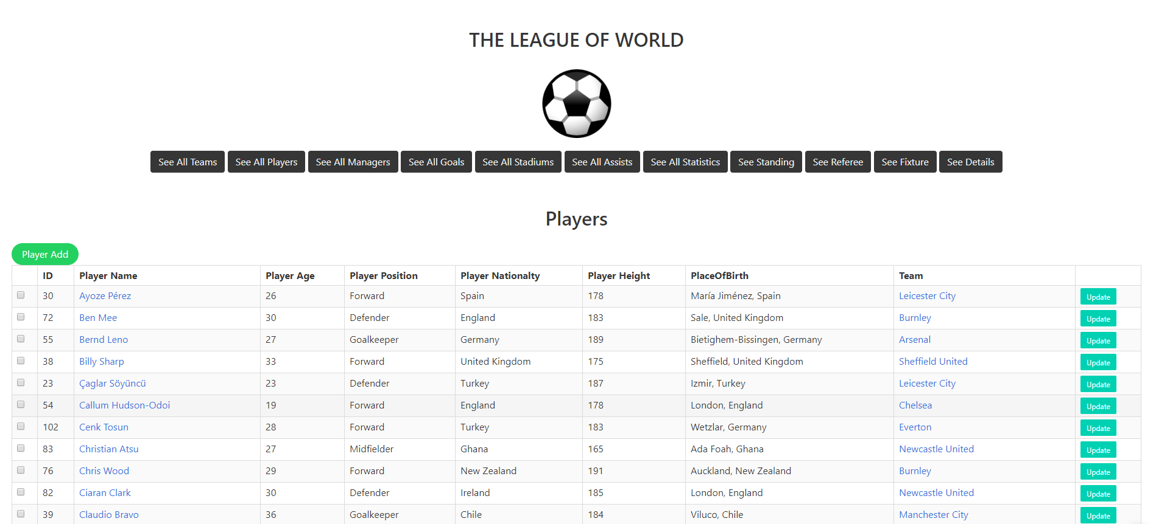
After logging in, the developer can see all players in this page by clicking the ‘See All Players button. Developer can delete and update the players.

Slide 35

Key access for player table in developer mode. By clicking to the name of the player will redict to the this page.

Slide 36
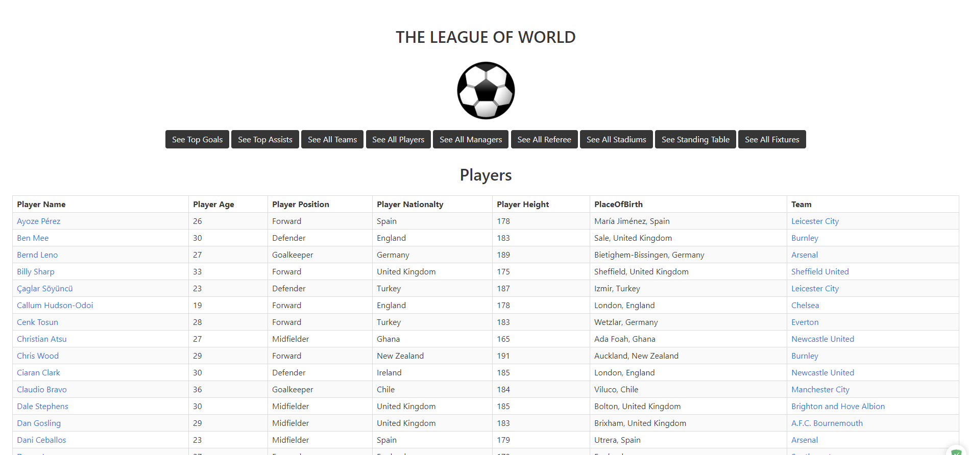
The user can see all players in this page by clicking the ‘See All Players’ button.

Slide 37
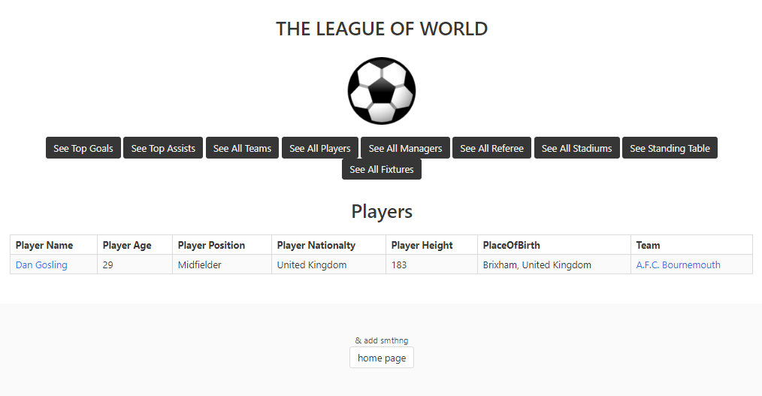
Key access for players table in user mode. By clicking to the name of the player will redict to this page

Slide 38
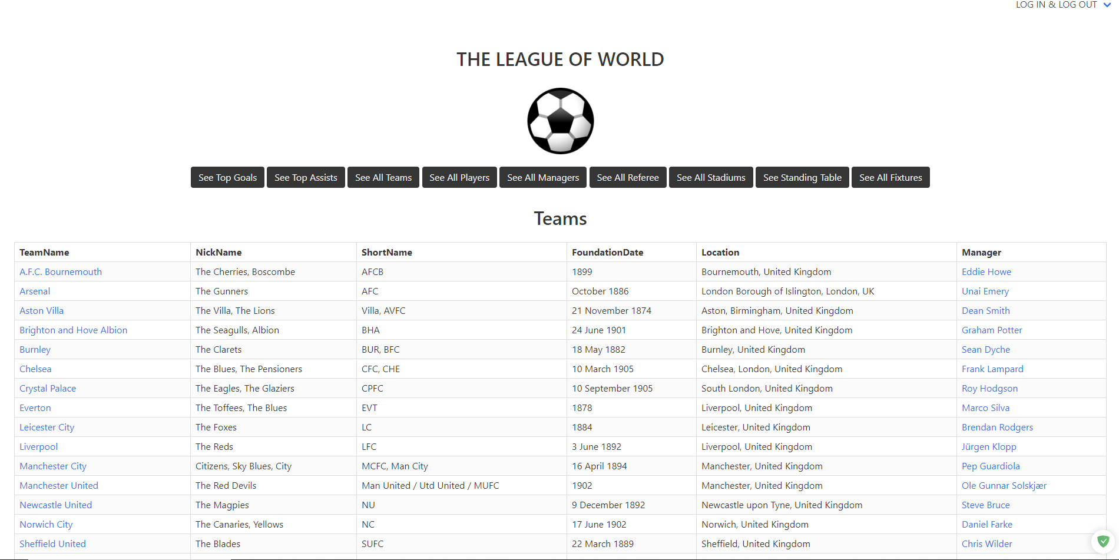
The user can see all teams in this page by clicking the ‘See All Teams’ button.

Slide 39
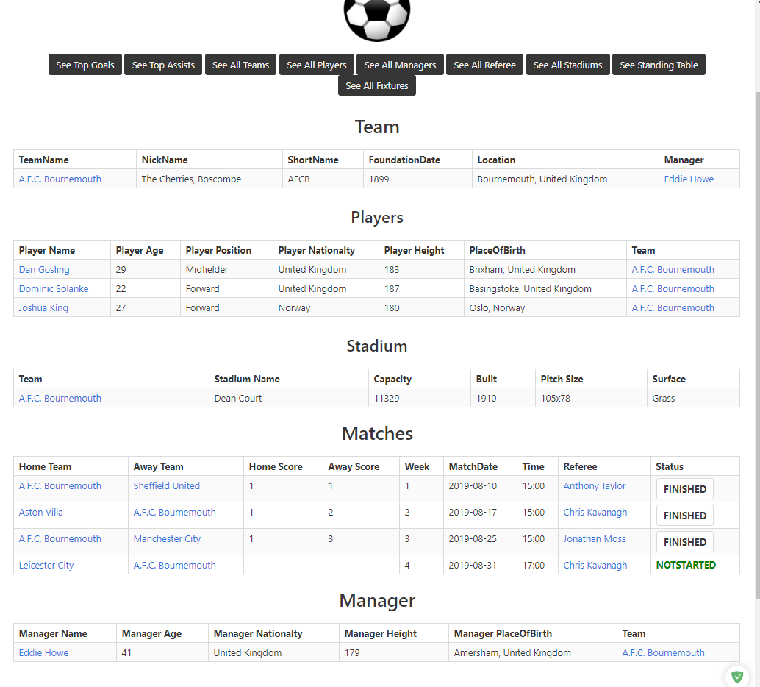
Key access for teams table in user mode.
By clicking name of the team will redirect to this page.
In this page all team players, stadium of the team, played or unplayed matches and manager of the team will be shown in this page.

Slide 40
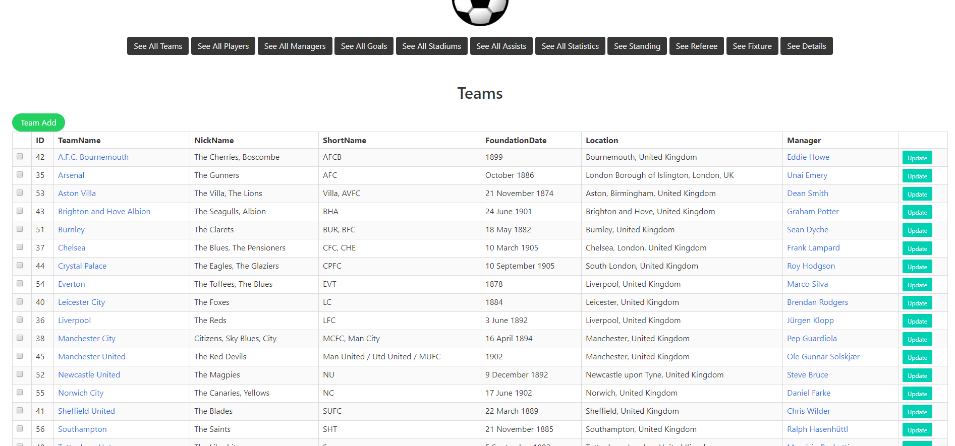
After logging in, the developer can see all teams in this page by clicking the ‘See All Teams’ button. Developer can delete and update the teams.

Slide 41
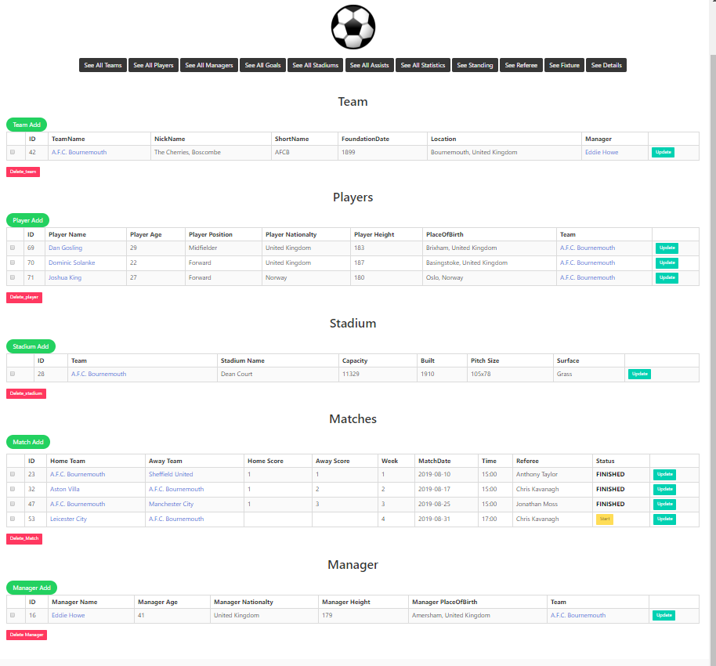
Key access for teams table in developer mode.
After loggining in, by clicking name of the team will redirect to this page.
In this page all team players, stadium of the team, played or unplayed matches and manager of the team will be shown in this page.
All buttons works properly.

Slide 42
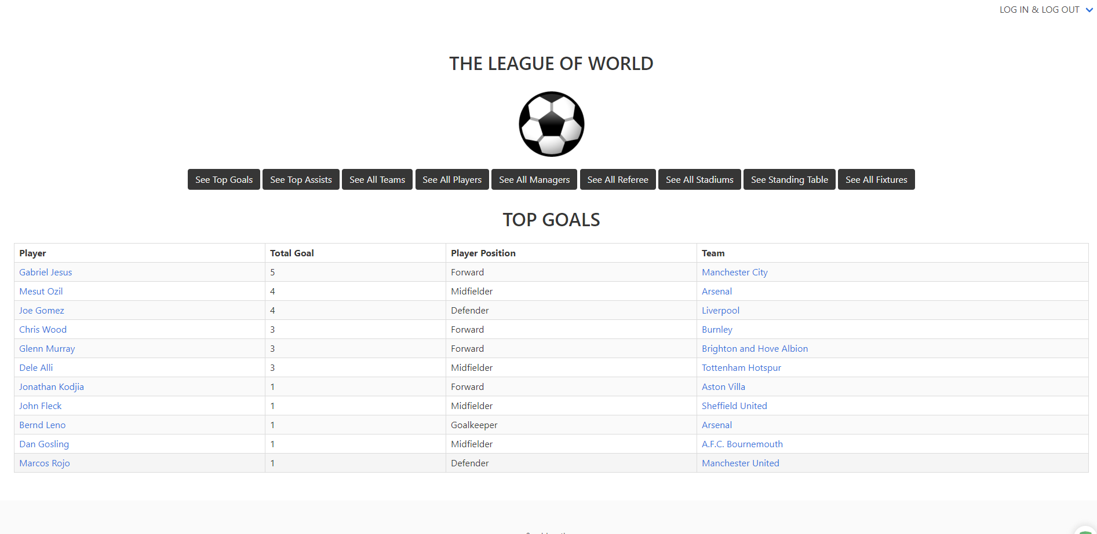
The user can see top goal player in this page by clicking the ‘See Top Goal’ button.

Slide 43
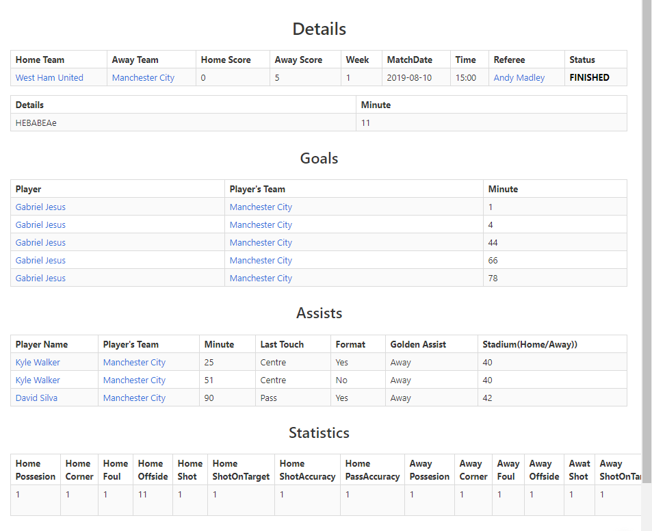
The user can see detailed match information in this page by clicking the ‘Finished or Live buttons in the fixture page.
If any new information is updated by developer in the live match page, and if the user refresh this page, user can see new informations.

Slide 44
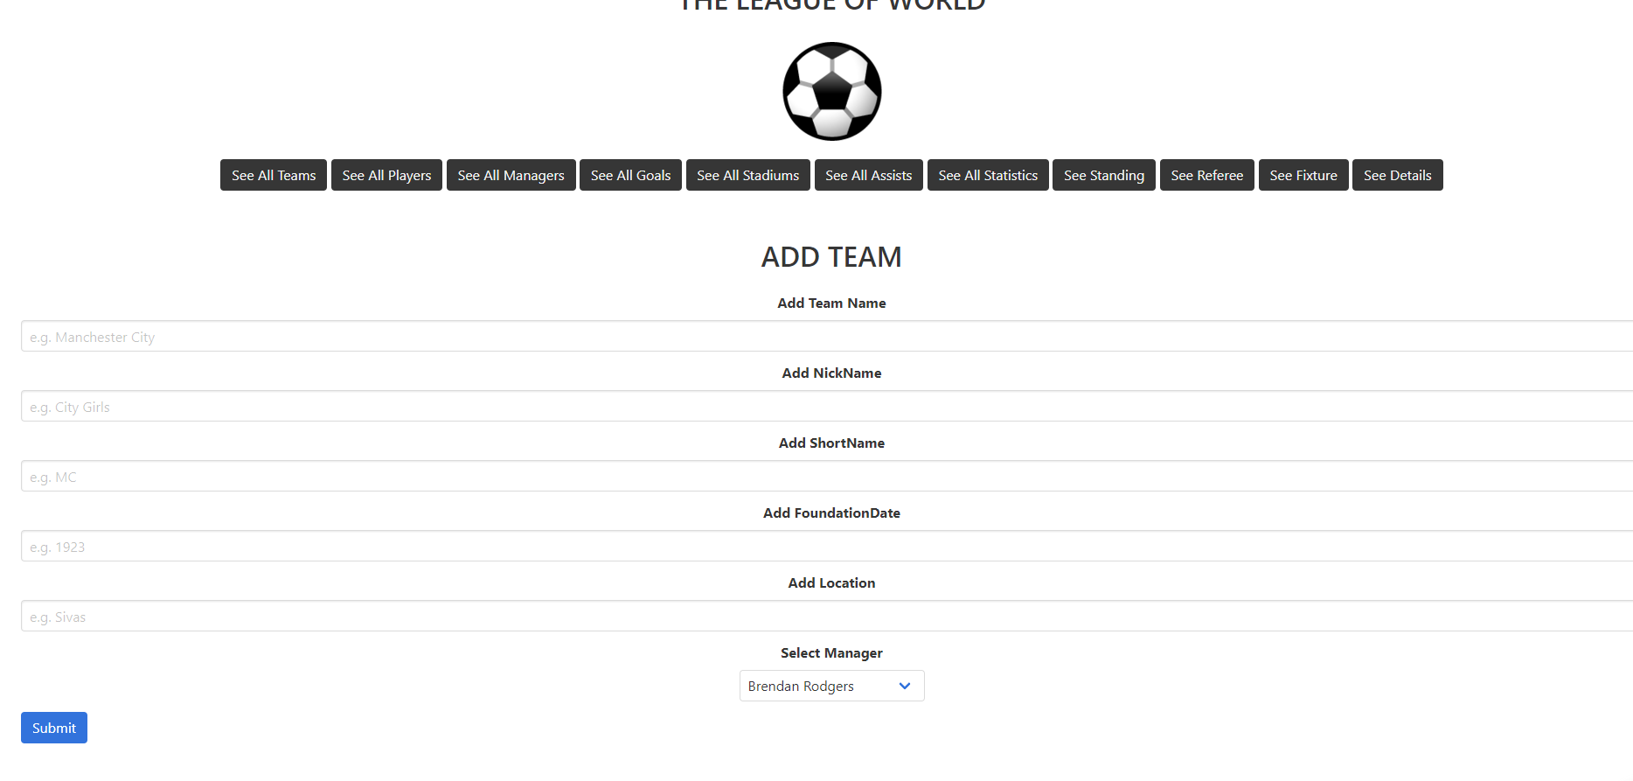
Team addding page for developer.

Slide 45
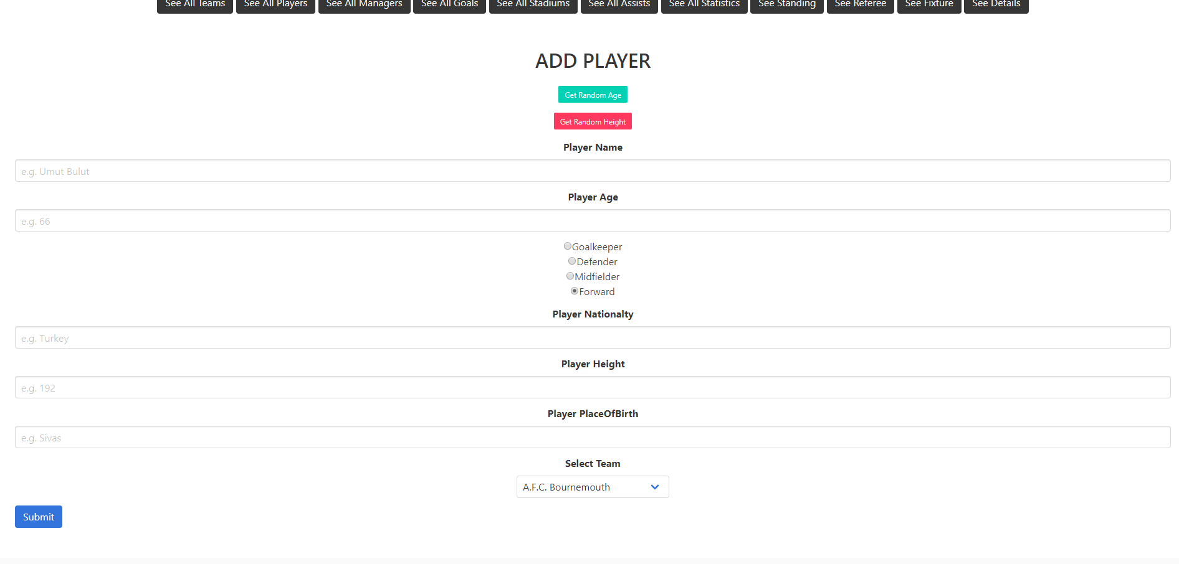
Player addding page for developer.

Slide 46
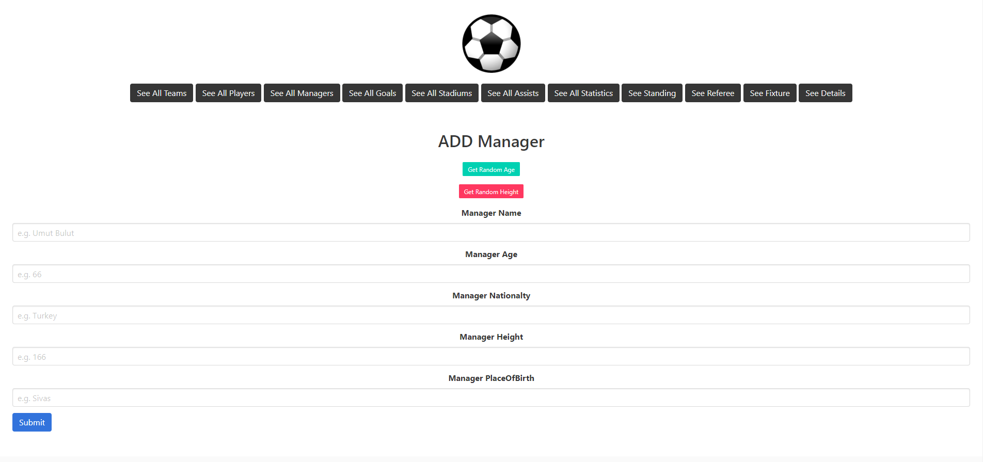
Manager addding page for developer.

Slide 47
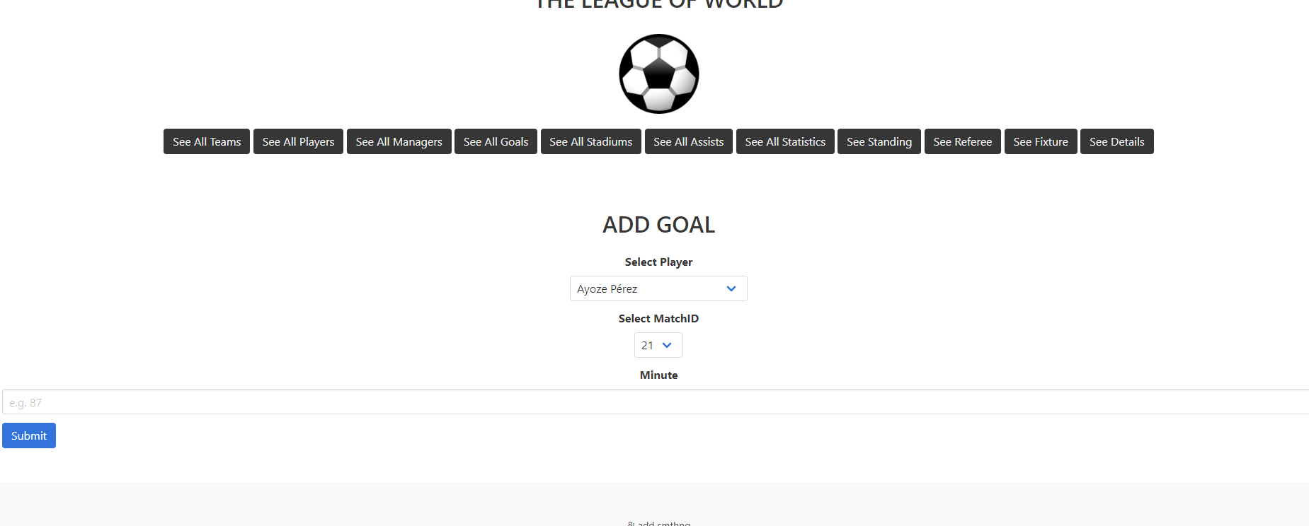
Goal addding page for developer.

Slide 48
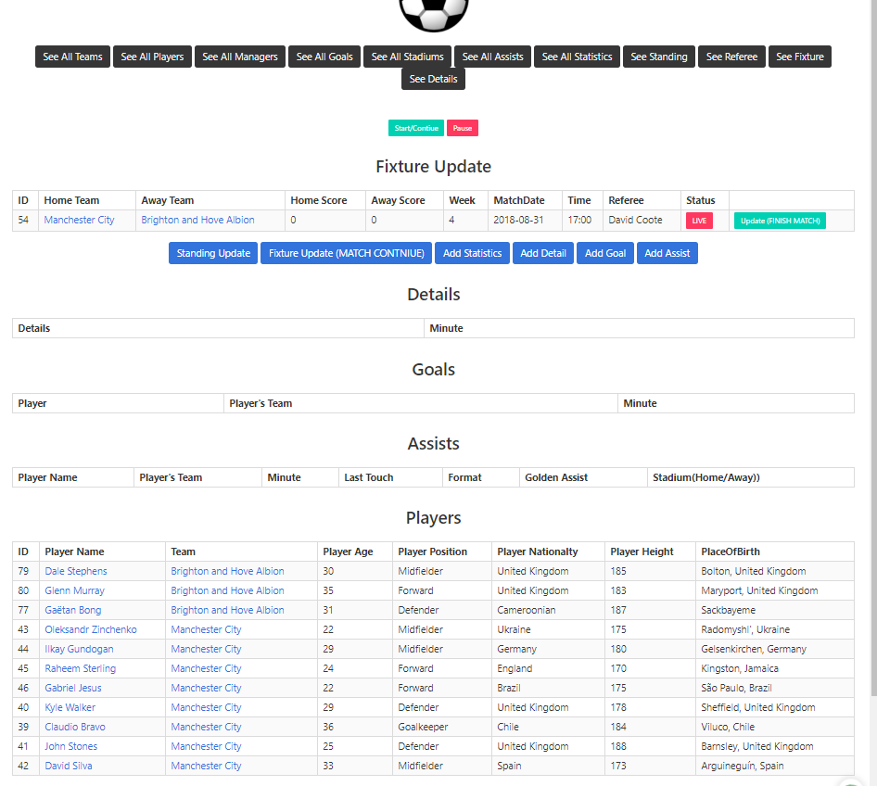
After logging in, the developer can start and control the match by clicking the ‘Live button’ in fixture table.
Developer can add detail, goal, assist and statistic via this page.
Each teams’ players are shown in this page.

